Slide 1
Deductive
and
Inductive Arguments
Sinto Jose Porathur

Slide 2
Every argument makes the claim that its premises provide grounds for the truth of its conclusion; that claim is the mark of an argument.

Slide 3
However, there are two very different ways in which a conclusion may be supported by its premises, and thus there are two great classes of arguments: the deductive and the inductive.

Slide 4
General View of Deductive Argument
Deductive inferences move from general to a particular.
It does indeed have a particular conclusion, inferred validly from two premises of which the first is general or universal proposition.

Slide 5
Example:
All humans are mortal
Socrates is human
Therefore Socrates is mortal

Slide 6
General View of Inductive Argument
A very common form of inductive argument is one in which a general or universal conclusion is inferred from a group of premisses all of which are particular.

Slide 7
Socrates is human and mortal.
Chandhu is human and mortal.
Joppan is human and mortal.
Therefore, probably all humans are mortal.

Slide 8
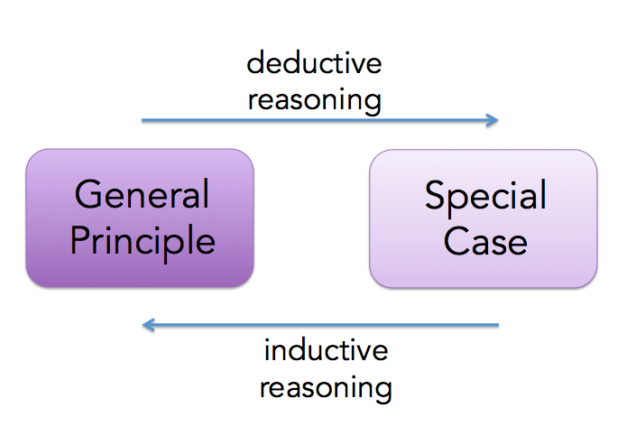

Slide 9
Is this explanation accurate?
Deductive Argument:
All animals are mortal.
All humans are animals.
Therefore, all humans are mortal.
Inductive Arguments:
All cows are mammals and have lungs.
All whales are mammals and have lungs.
All humans are mammals and have lungs.
Therefore, probably all mammals have lungs.

Slide 10
These counterexample shows that it is not satisfactory to characterize deductive arguments as those in which particular conclusions are inferred from general premisses; nor is it satisfactory to characterize inductive arguments as those in which general conclusions are inferred from particular premisses.

Slide 11
Deductive Argument
A deductive argument makes the claim that its conclusion is supported by its premises conclusively.(= The quality of being final or definitely settled)
Deductive arguments are those that involve necessary reasoning.

Slide 12
Stated more precisely, a deductive argument is an argument incorporating the claim that it is impossible for the conclusion to be false given that the premises are true.

Slide 13
Example:
All humans are mortal
Socrates is human
Therefore Socrates is mortal

Slide 14
If it is true that all men are mortal, and if it is true that Socrates is a human, then it must be true that Socrates is mortal no matter what else may be true in the world and no matter what other premises are added or other information discovered.

Slide 15
If we find that Socrates is ugly or that angels are immortal or that cows give milk, it affects the validity of the argument NOT one bit.

Slide 16
Inductive Argument
An inductive argument does not make any claim.
An inductive argument is an argument incorporating the claim that it is improbable that the conclusion be false given that the premises are true.
Inductive arguments involve probabilistic reasoning.

Slide 17
Example:
Most corporation lawyers are conservatives.
Barbara shane is a cooperation lawyer.
Therefore Barbara Shane is probably a conservative.

Slide 18
If we add the premisses…….
Barbara Shane is an officer of American Civil Liberties Union(ACLU)
Most officers of the ACLU are not conservatives.
Now the conclusion no logger seems very probable; the original inductive argument has been greatly weakened by the presence of this additional information about Barbara Shane.

Slide 19
Every argument either makes this claim of conclusiveness (explicitly or implicitly) or does not make it, every argument is either deductive or inductive.

Slide 20
Validity and Truth
If the conclusion follows with logical necessity from the premises, we say that the argument is valid.

Slide 21
Therefore validity can never apply to any single proposition by itself, because the needed relation cannot possibly be found within any one proposition.

Slide 22
Truth and falsehood, on the other hand, are attributes of individual propositions.
A single statement that serves as a premise in an argument may be true; the statement that serves as its conclusion may be false.

Slide 23
For logicians the term validity is applicable only to deductive arguments.
Inductive arguments make weaker claims than those made by deductive arguments. Because their conclusions are never certain, the terms validity and invalidity do not apply to inductive arguments.

Slide 24
To say that a deductive argument is valid is to say that it is not possible for its conclusion to be false if its premises are true.
Thus we define validity as follows: A deductive argument is valid when, if its premises are true, its conclusion must be true.

Slide 25
Truth
Truth is the attribute of those propositions that assert what really is the case.
When I assert that Lake Superior is the largest of the five Great Lakes, I assert what really is the case, what is true.

Slide 26
If I had claimed that Lake Michigan is the largest of the Great Lakes my assertion would not be in accord with the real world; therefore it would be false.

Slide 27
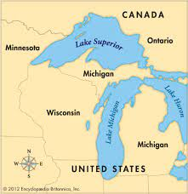

Slide 28
Truth and falsity are attributes of individual propositions or statements; validity and invalidity are attributes of arguments.

Slide 29
An argument may be valid even when its conclusion and one or more of its premises are false.
The validity of an argument depends only on the relation of the premises to the conclusion.

Slide 30
Some valid arguments contain only true propositions—true premises and a true conclusion:
All mammals have lungs.
All whales are mammals.
Therefore all whales have lungs.

Slide 31
Some valid arguments contain only false propositions—false premises and a false conclusion:
All four-legged creatures have wings.
All spiders have exactly four legs.
Therefore all spiders have wings.

Slide 32
This argument is valid because, if its premises were true, its conclusion would have to be true also—even though we know that in fact both the premises and the conclusion of this argument are false.

Slide 33
Some valid arguments have false premises and a true conclusion:
All fishes are mammals.
All whales are fishes.
Therefore all whales are mammals.
The conclusion of this argument is true, as we know; moreover, it may be validly inferred from these two premises, both of which are wildly false.

Slide 34
Some invalid arguments contain only true propositions—all their premises are true, and their conclusions are true as well:
If I owned all the gold in Fort Knox, then I would be wealthy.
I do not own all the gold in Fort Knox.
Therefore I am not wealthy.

Slide 35
The true conclusion of this argument does not follow from its true premises.
This will be seen more clearly when the immediately following illustration is considered.

Slide 36
Some invalid arguments contain only true premises and have a false conclusion.
This is illustrated by an argument exactly like the previous one in form, changed only enough to make the conclusion false.

Slide 37
If Bill Gates owned all the gold in Fort Knox, then Bill Gates would be wealthy.
Bill Gates does not own all the gold in Fort Knox.
Therefore Bill Gates is not wealthy.

Slide 38
This shows that for being a wealthy man does not always need the gold from Fort Knox.
If one wins the lottery, he will get money.

Slide 39
If an argument is valid and its premises are true, we may be certain that its conclusion is true also.
To put it another way: If an argument is valid and its conclusion is false, not all of its premises can be true.
Some perfectly valid arguments do have false conclusions, but any such argument must have at least one false premise.

Slide 40
Sound Argument
When an argument is valid and all of its premises are true, we call it sound. The conclusion of a sound argument obviously must be true—and only a sound argument can establish the truth of its conclusion.

Slide 41
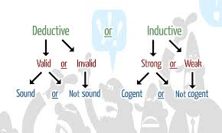

Slide 42
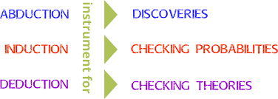

Slide 43
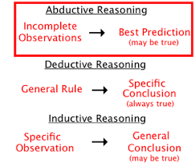

Slide 44
Syllogism
Syllogism, in logic, a valid deductive argument having two premises and a conclusion.
The traditional type is the categorical syllogism in which both premises and the conclusion are simple declarative statements that are constructed using only three simple terms between them, each term appearing twice (as a subject and as a predicate): “All men are mortal; no gods are mortal; therefore no men are gods.”

Slide 45
Examples of Arguments
All crows are black.
John is black.
Therefore, John is a crow.

Slide 46
Invalid. See Why?
The first premise is saying that all crows are black, but not that all black things in the universe are crows! So EVEN IF John is black and EVEN IF all crows are black (both premises being true), we know nothing else about John.
The conclusion can be true or false, EVEN IF the premises are true. Invalid.

Slide 47
Valid! See why?
We don't judge the reasoning by the content. The first premise is false, but this is not relevant to judging the reasoning.
If these premises are true, we are locked into the conclusion.

Slide 48
Only crows are black.
John is black.
So, John is a crow.

